Slide 1
NCI HPC Data Management Prototyping Project Briefing: Background, Progress, Lessons Learned, and Plans for the Future
February XX, 2016

Slide 2
Agenda
Summary
Introduction/Background
FNL Sequencing Facility Use Case
HPC DM Prototyping Concept and Rationale
HPC DM Solution Architecture
HPC DM Prototyping History & Current Status
FNL Sequencing Facility Adoption (UAT)
Connect with Cleversafe Object Store
Lessons Learned
Plans for the Future – What is expected
Questions & Answers

Slide 3
Summary
Scientific data management and services are becoming critical part of the NCI High Performance Computing strategy and research mission
We identify and focus prototyping effort on the FNL Sequencing Facility use case
Our technological response to address the expanding role is built around the concept of core APIs, leveraging largely adopted Globus/GridFTP, and building an interface on an integrated rule-oriented data system (iRODS) implementation
We assess technologies, test and refine the interface/APIs for taking datasets in and sharing datasets out to ensure no-loss datasets archiving, base-level dataset registration and metadata-based sharing and search capability

Slide 4
Introduction/Background
NCI is in critical need of advancing its core scientific and technological means of data management and services from large, diverse, distributed and heterogeneous datasets
Large datasets are currently maintained in multiple copies across physical storage in an isolated fashion, leading to an unnecessary expense
Annotation and registration of datasets is inherent for managed datasets to effectively deliver broader scientific impact
Strategically, the absence of an effective data management solution presents a barrier to supporting emerging efforts to leverage the breadth of generated datasets for use in development of computationally and data intensive predictive models as well as efforts to utilize cloud resources for collaboration and analysis.

Slide 5
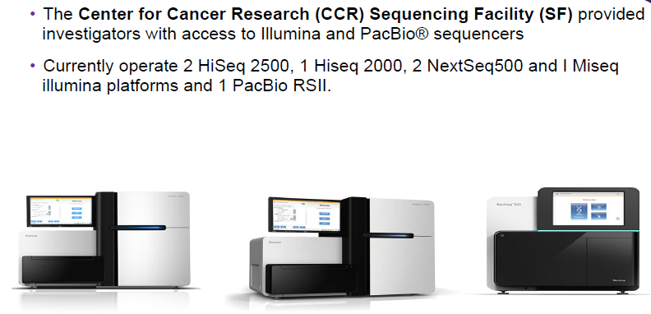
FNL Sequencing Facility Use Case - CCR-Sequencing Facility (SF)

Slide 6
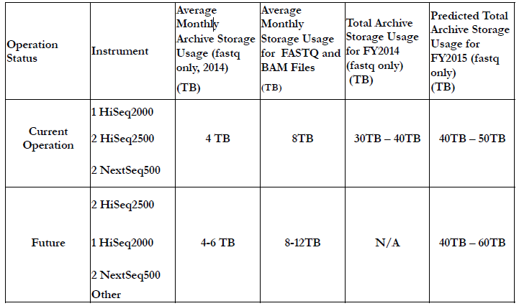
FNL SF Current and Future Archive Storage Estimate

Slide 7
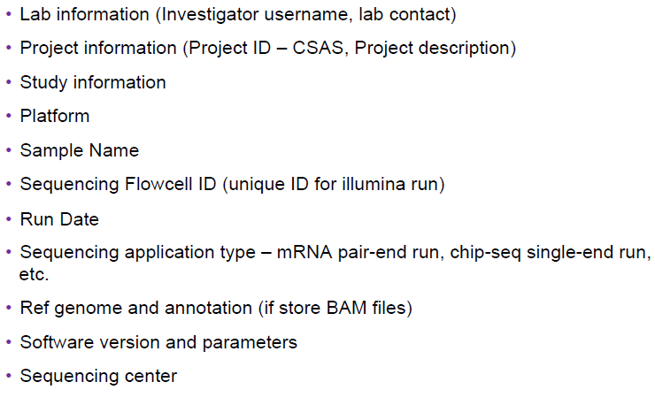
FNL Sequencing Facility Metadata for Archive

Slide 8
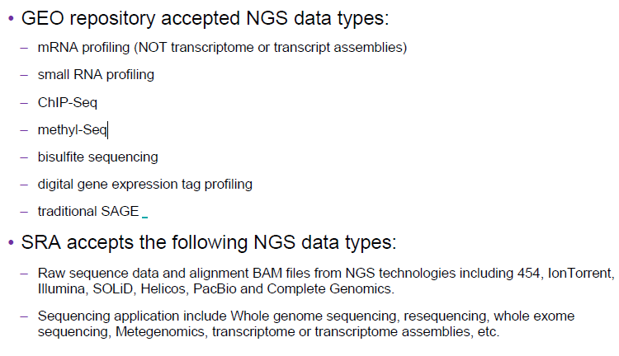
Data Submission to GEO and SRA

Slide 9
FNL Sequencing Facility Use Case Summary
SF needs to register CSAS project and associated metadata
SF needs to register, store, transfer and share scientific data/dataset or files with investigators or collaborators
Existing custom SF LIMS system has a full set of metadata related to project, dataset or data file
Globus tools have been adopted as mature technology for SF to transfer and share large sequencing datasets with CCR collaborators
SF needs to have a permanent archive of their annotated datasets vs pieces of many data islands to share with collaborators and enable metadata-based data life cycle

Slide 10
HPC DM Prototyping Concept and Rationale
Assess technology to focus on adding value for identified use cases
Re-use and enhance vs invent new tools to address SF needs
Empower SF: Register, store, transfer and share scientific data/dataset or files with investigators or collaborators
Provide core capabilities to get started , but extensible to accommodate future need
Implement/enhance HPC data management core APIs based on iRODS iCAT and Jargon core APIs – The APIs will be agnostic of physical storage medium or device being utilized
Implement HPC DM command and batch utilities with no interference of currently SF adopted Globus workflow
Establish a highly flexible and yet reliable storage model for underlying datasets integrated into the data/metadata collection and registration system

Slide 11
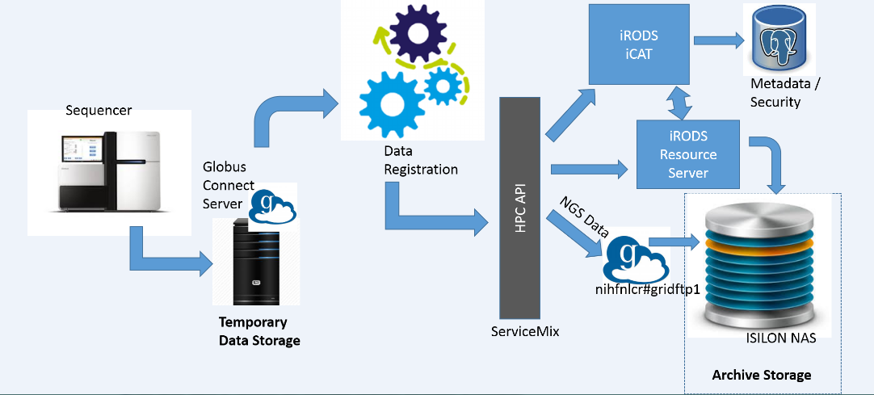
HPC Data Management-Registration-Storage Workflow

Slide 12
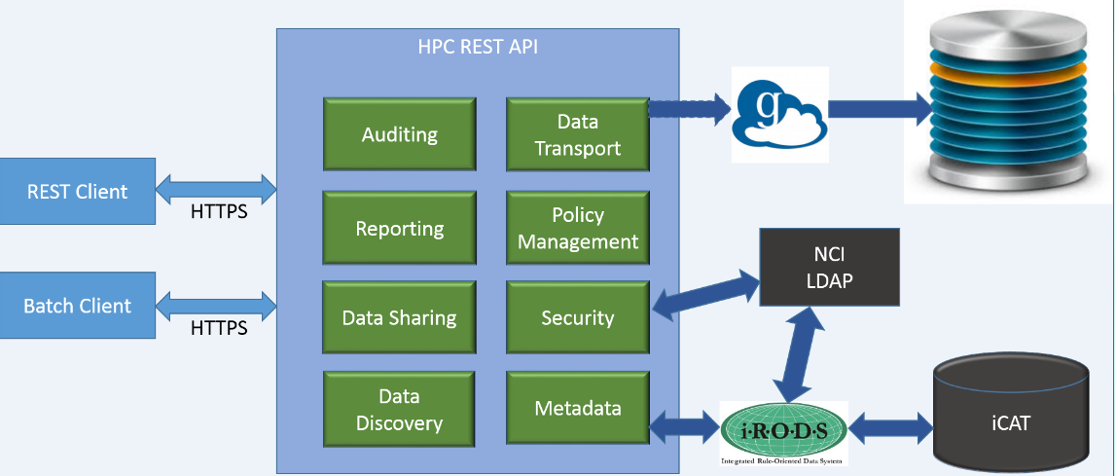
HPC Data Management Solution Upstream High Level Design

Slide 13
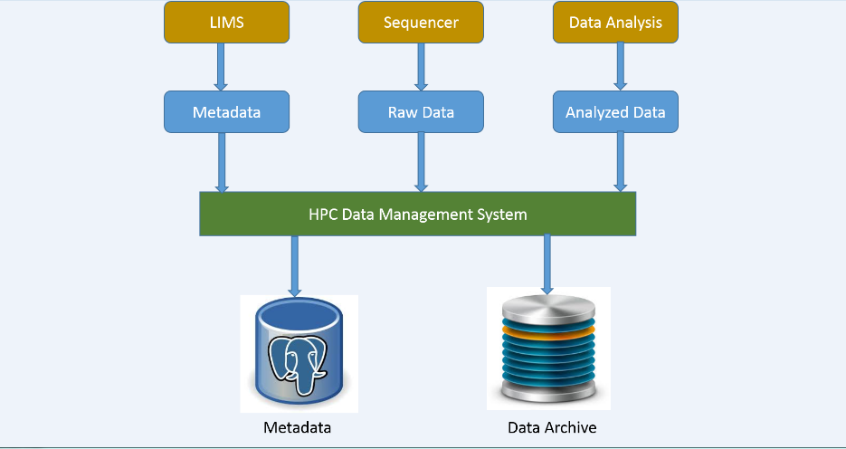
HPC Data Management Upstream Overall Dataflow

Slide 14
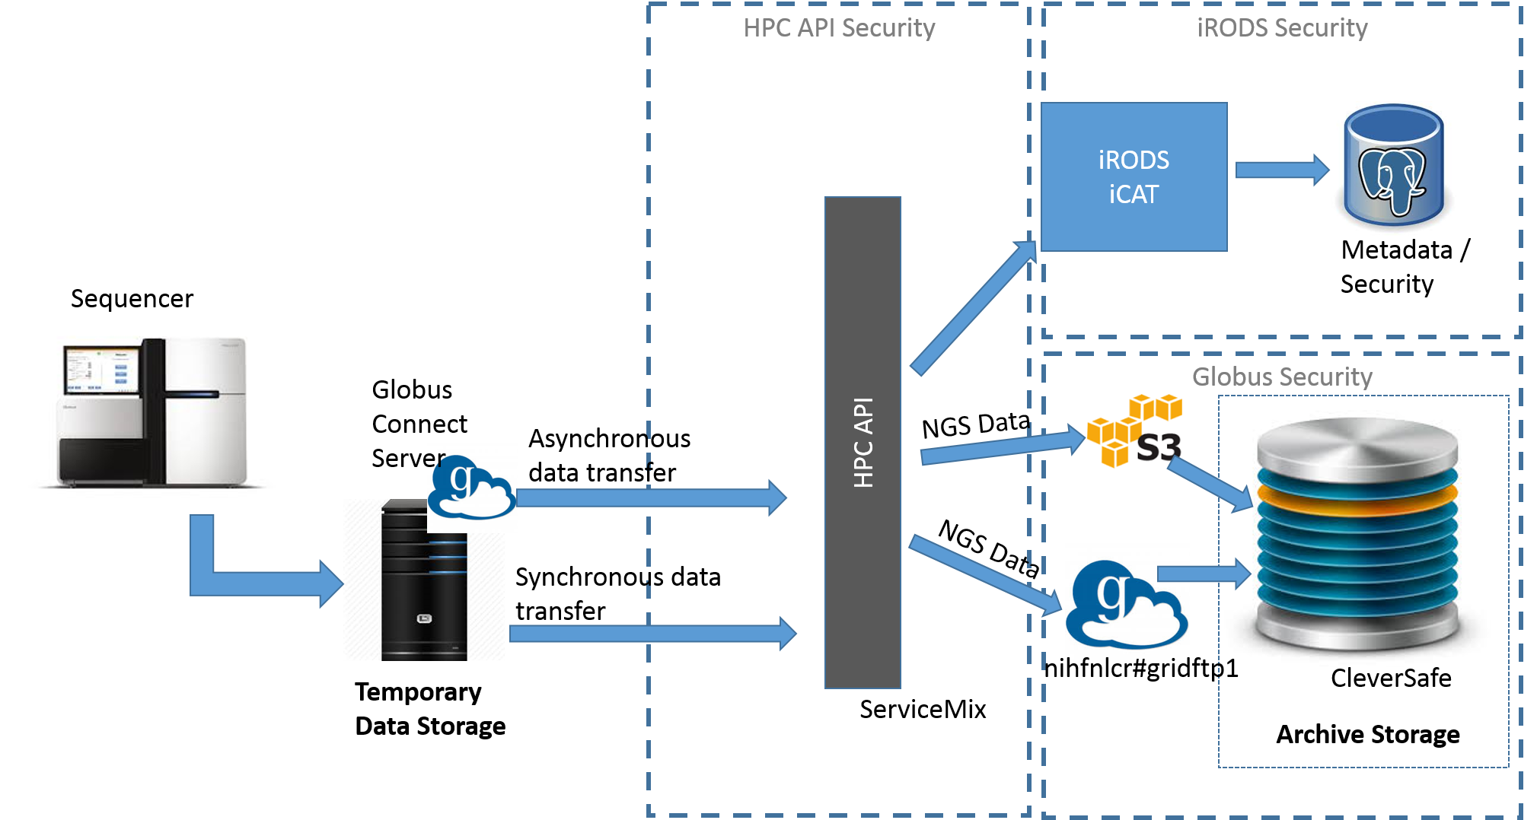
HPC Data Management Workflow with Cleversafe

Slide 15
HPC DM Prototyping Technology/Software List
Name | Version | Comment
iRODS | 4.1.0 | iCAT and IRES
Globus Connect Server | 2.2.x | Globus endpoint connected object store
Service Mix | 6.0.x | Container for HPC API
Postgres | 9.5.x | iCAT database to store metadata and manage security
JDK | 1.8.x

Slide 16
HPC DM Prototyping History & Current Status
Project kicked off April 2014 with 3.5 full time SVG development resources. SVG development resources were cut down to 1.5 since Dec 2015
No separate QA team – agile development approach
Evaluated custom schema in Mongo, custom APIs and switched to Postgres iRODS implementation for metadata management
Assessed Clever Safe Cloud S3 using iRODS
Majority infrastructure support provided by the FNL ITOG/System Team and some SRA team @Shady Grove
Preparing the Pre-Production VM @FNL for UAT: Add NAS, documentation, minor fixes, demo. Work with SF LIMS team to confirm batch input file format/acceptance
Stabilize/enhance APIs and documentations with UAT feedback: Design, API specification, User Guide, and Batch support spec

Slide 17
FNL Sequencing Facility Adoption (UAT)
Globus end point and path prepared and ready to archive for UAT
Walkthrough, documentation, demo and training to be provided
API Specification, User Guide and Batch Support Specification to be handed over
Expect UAT to be started: Feb 2016
Expect SF to use the HPC DM batch utility and Globus to register metadata, transfer data files to allocated isilon storage archive, and share with collaborators in UAT
Enhancement requests, issues or bugs tracked through JIRA tracker
Ongoing support to be provided

Slide 18
Connect with Cleversafe Object Store
Explore Globus in connecting to Cloud Object Store
Explore configuration options to connect Cleversafe using Globus transfer and Cloud based object store
Explore Globus S3 API to transfer data object to Cleversafe
Explore Globus tools to administer data object authorizations in Cleversafe
Validate Globus in connecting to NCI Object Store
Configure Globus Server instance to connect with the DEV vault of NCI Cleversafe within firewall
Verify HPC DM stabilized APIs and command line utilities within the NCI Globus/Cleversafe setting
Incorporate scripts into Jenkins CI process
Develop, promote and Adapt DevOps operating procedures and automation per users categories

Slide 19
HPC DM Prototyping Lessons Learned
Process/Technical Assumptions or Notes
Globus and iRODS security: Archived datasets subject to Globus access control while fall under iRODS security during the registration/annotation via HPC APIs or command/batch utility
Infrastructure & System Admin Support: There were delays in getting VM, firewall exceptions, software, and system related issues resolved. There is no dedicated system resource from ITOG and no system admin on the contract – Need better planning for future improvement.
Full single signon using NCI LDAP dependent on the Globus next release
Items that went well
CCR, SF, and CBIIT very supportive during the requirements gathering process and provided timely feedback/use-cases and model guidance.
CCR actively engaged and provided valuable guidance at critical point to transition to iRODS open source direction
SF provided timely feedback on work products
Project successfully adopted an agile approach and constantly prioritized activities/tasks based on risks, constraints and scope

Slide 20
Plans for the Future – What is expected
Train and promote HPC command and utility adoption for SF:
Track and resolve issues, bugs or enhancement requests as prioritized
Stabilize APIs and documentations
Lead or assist with other NCI or FNL divisions or labs in adopting the HPC DM APIs with identified business objectives
Explore further and assess iRODS technology for potential customers without Globus
iRODS – isilon
iRODS – Clever Safe
Validate/confirm HPC DM APIs in a pre-production environment in connection with NCI Cleversafe UAT Vault
Explore, develop and configure Jenkins CI in Production VM along Cleversafe Production Vault and Globus for SF
Maintain Operational upstream in a Production environment in connection with NCI Cleversafe Production Vault for SF and potentially other divisions

Slide 21
Questions & Answers
?

